Slide 1
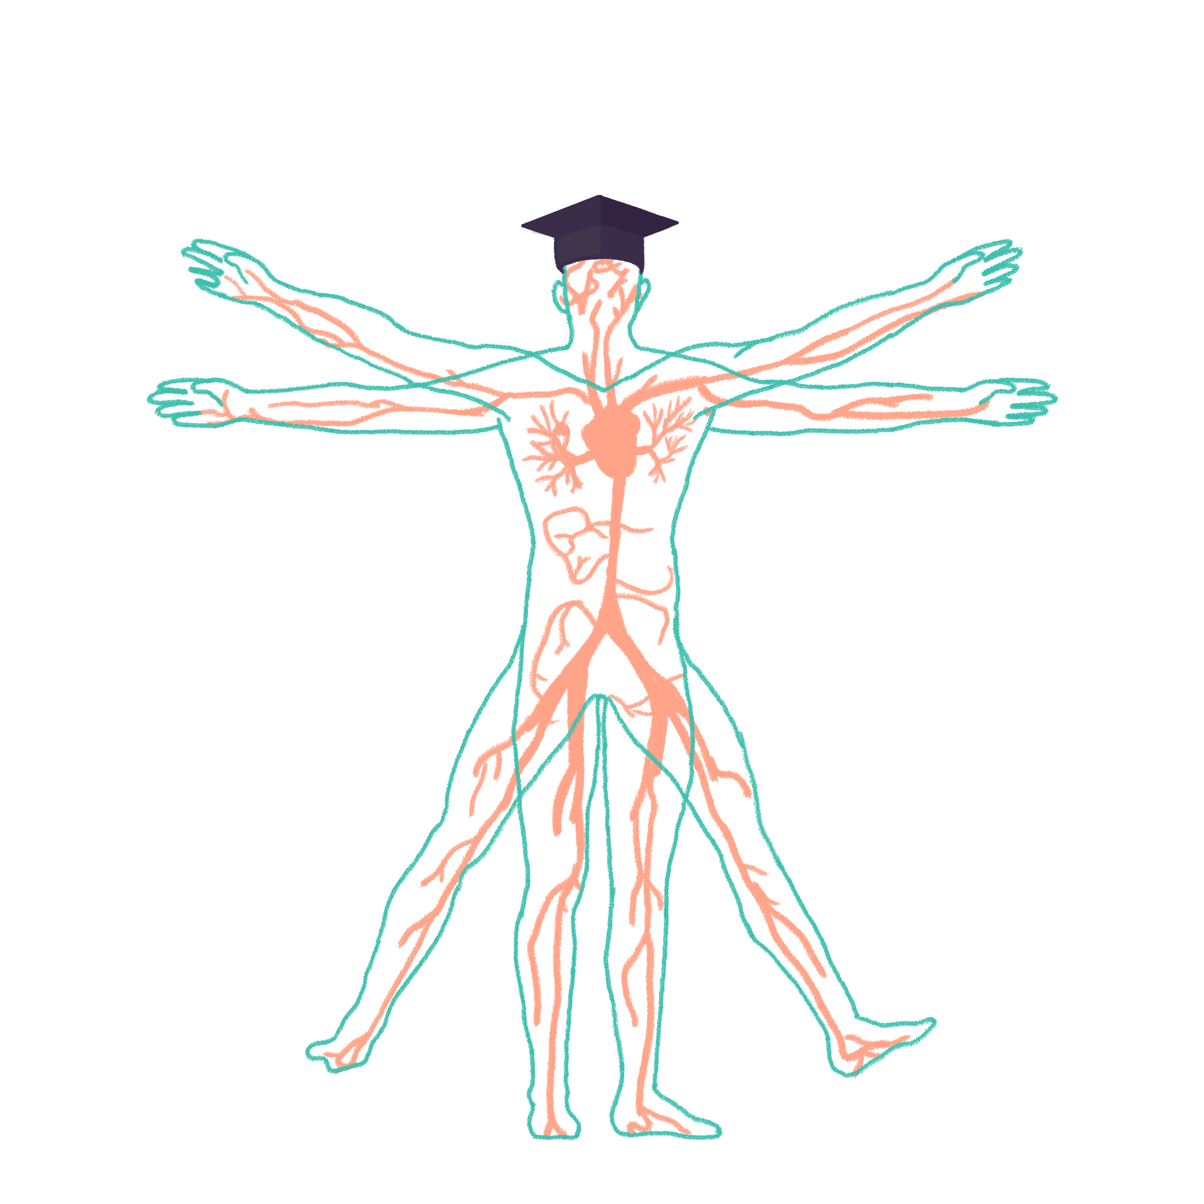
2023/2024

Slide 2
Neuroscience [1]
This session will be recorded
Phase 1 Revision Session
Duha Mahmood & Andrew Macdonald
29/02/2024
The Peer Teaching Society is not liable for false or misleading information…

Slide 3
Aims and Objectives
We are going to cover:
Cerebral Vasculature
Cranial Nerves
Pathways
Vision
Auditory System
We aim to focus on physiology as Neurosoc will be revising Neuroanatomy with you guys :)
The Peer Teaching Society is not liable for false or misleading information…

Slide 4
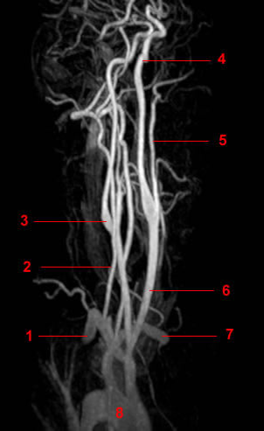
Cerebral Vasculature
Two sets of blood supply:
The paired internal carotid arteries, and the paired vertebral arteries
The ICA arise at C4, and enter via the carotid canal of the temporal bone
The vertebral arteries arise from the subclavian arteries
The Peer Teaching Society is not liable for false or misleading information…

Slide 5
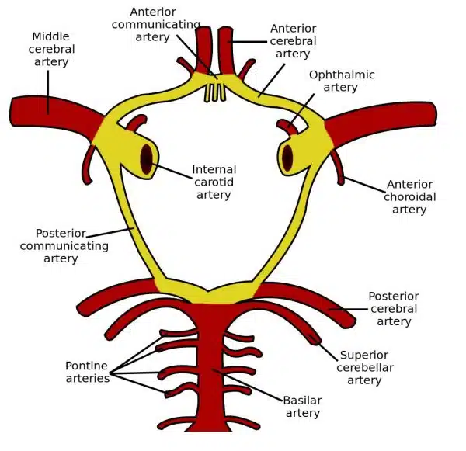
The Circle of Willis
This is where the internal carotid and vertebral arteries join
There are 2 contributors, the paired ICA’s, and the basilar artery
This gives rise to the cerebral arteries
These are joined by the anterior and posterior communicating arteries
The Peer Teaching Society is not liable for false or misleading information…

Slide 6
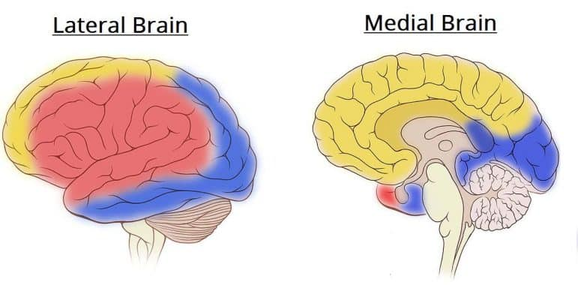
The Cerebral Arteries
There arises 3 arteries from the circle of willis supplying the left and right cerebrum.
The overall supply of each of these is seen on the right.
The Peer Teaching Society is not liable for false or misleading information…

Slide 7
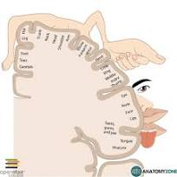
Anterior Cerebral Artery
Supplies the medial frontal and parietal lobes.
Frontal lobe- motor
Parietal- sensation
Lesion to ACA= contralateral hemiparesis and hemiplegia. Affecting lower limb> upper limb
The Peer Teaching Society is not liable for false or misleading information…

Slide 8
Middle Cerebral Artery
Lateral frontal, parietal and temporal lobes supplied.
Hemiparesis and hemiplegia affecting upper over lower limb
Hemianopia due to lesion to visual pathway
Aphasia due to lesion to Wernicke's or Broca's area
The Peer Teaching Society is not liable for false or misleading information…

Slide 9
Posterior Cerebral Artery
Supplies the occipital lobe and posteromedial temporal lobe
Occipital lobe- visual cortex
Lesion- contralateral homonymous hemianopia with macular sparing
Visual agnosia
The Peer Teaching Society is not liable for false or misleading information…

Slide 10
Question:
Which vessel supplies the majority of the blood to the cerebrum in the cerebral vasculature?
Internal carotid artery
Vertebral artery
Middle cerebral artery
Basilar artery
Anterior cerebral artery
The Peer Teaching Society is not liable for false or misleading information…

Slide 11
Answer:
C) Middle Cerebral Artery
The Peer Teaching Society is not liable for false or misleading information…
Notes:
Image Ref: https://teachmeanatomy.info/neuroanatomy/vessels/arterial-supply/

Slide 12
Question:
Name the artery responsible for supplying the occipital lobe and the inferior aspect of the temporal lobe in the cerebral vasculature.
The Peer Teaching Society is not liable for false or misleading information…

Slide 13
Answer:
Posterior Cerebral Artery
The Peer Teaching Society is not liable for false or misleading information…

Slide 14
Question:
Which artery is NOT part of the Circle of Willis?
Anterior cerebral artery
Posterior cerebral artery
Middle cerebral artery
Vertebral artery
Internal carotid artery
The Peer Teaching Society is not liable for false or misleading information…

Slide 15
Answer:
D) Vertebral artery
The Peer Teaching Society is not liable for false or misleading information…

Slide 16
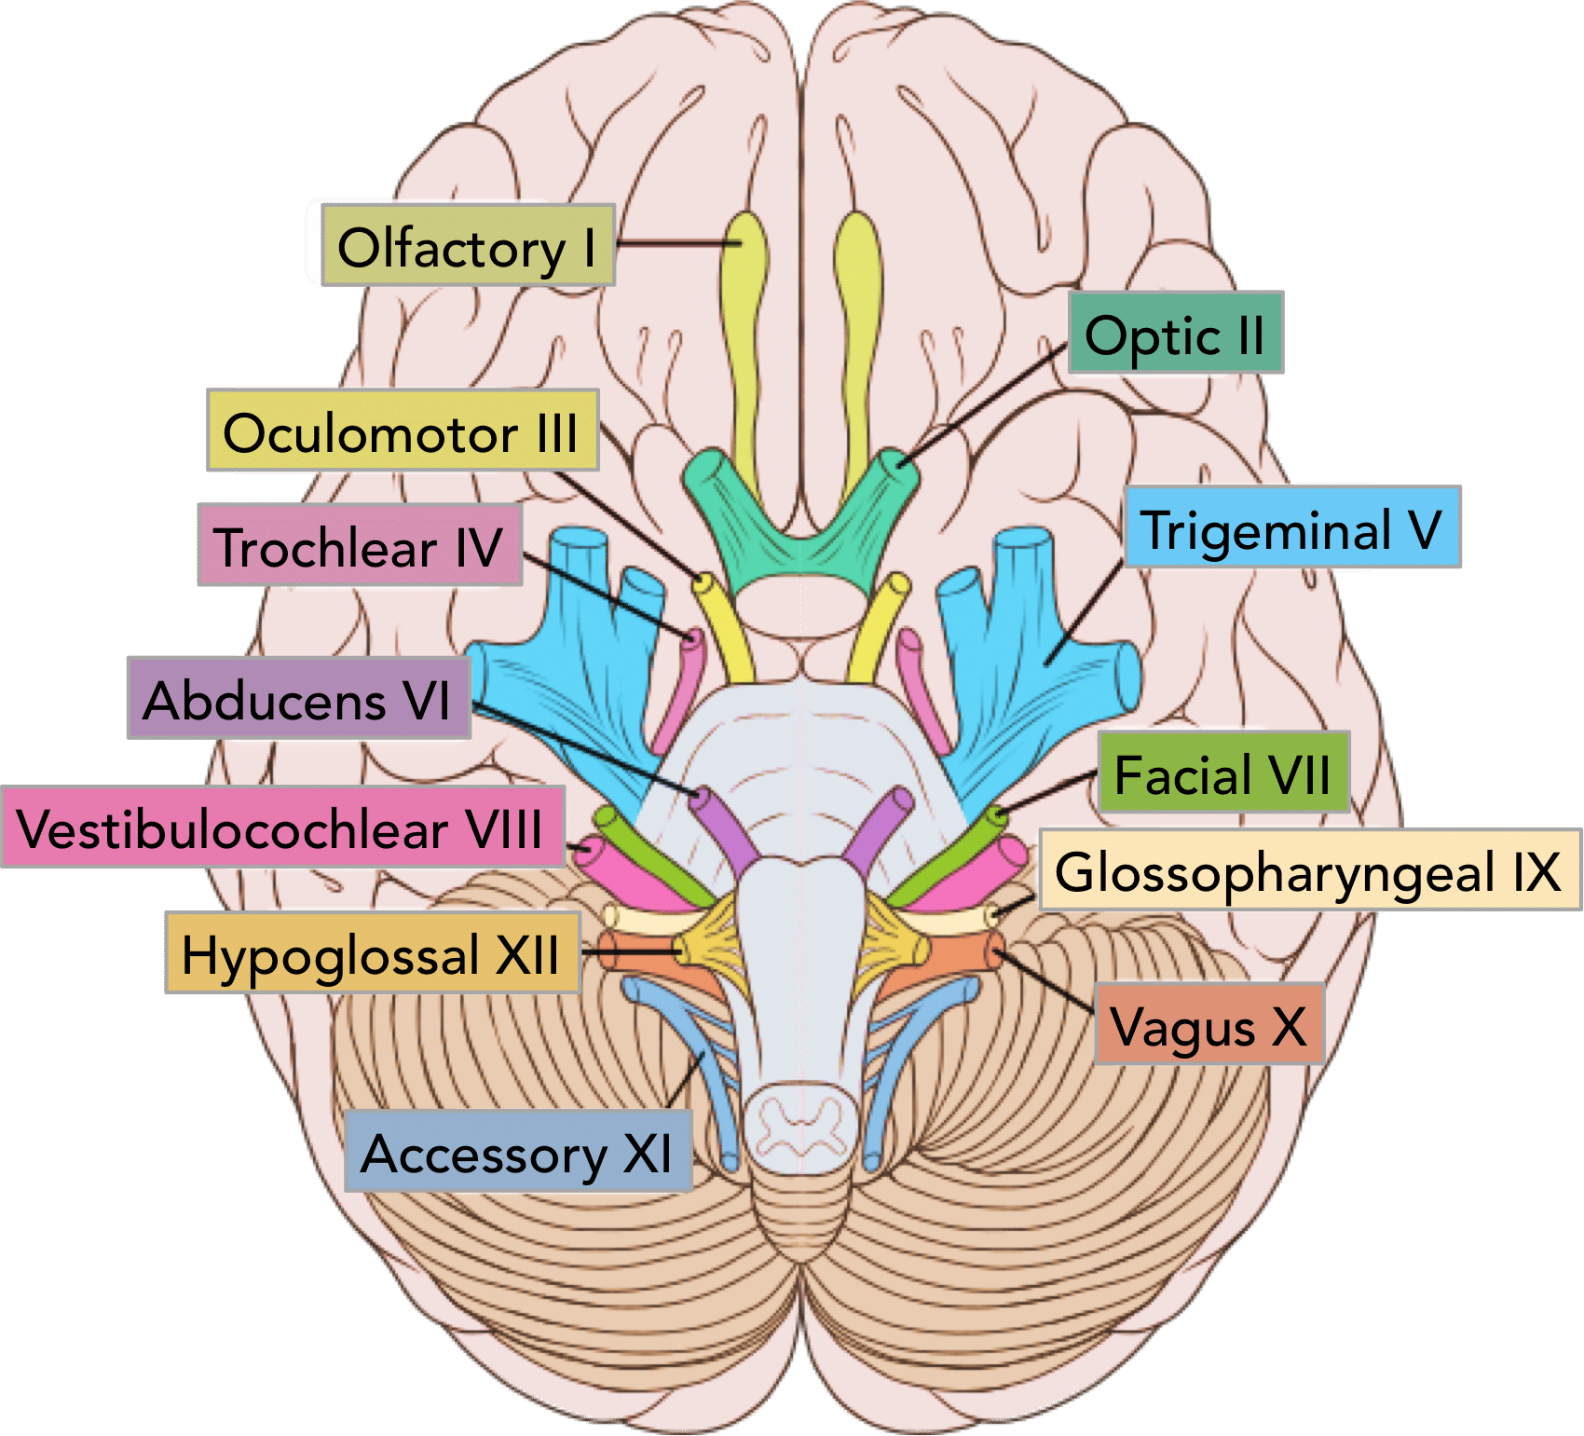
Cranial Nerves
The Peer Teaching Society is not liable for false or misleading information…
Notes:
Image Reference: https://teachmeanatomy.info/head/cranial-nerves/summary/

Slide 17
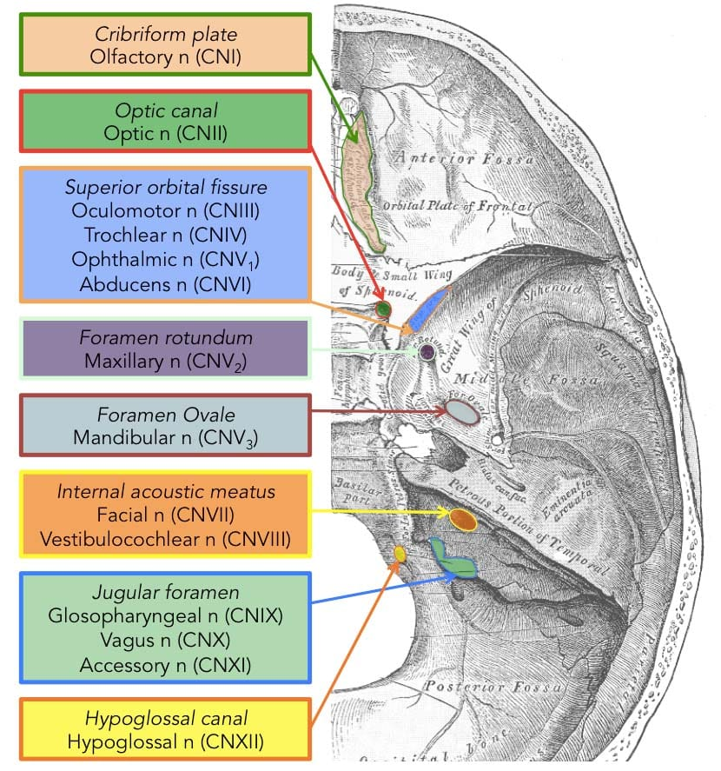
Cranial nerves- exits
A good diagram to remember
The main takeaway is that cranial nerves exit the skull from front to back, with CN1 leaving at the front and CN12 leaving at the back (more or less)
CN 2 and 12 leave via canals, optic and hypoglossal
The Peer Teaching Society is not liable for false or misleading information…

Slide 18
The function and name of the cranial nerves
Oh oh oh to touch and feel very good velvet, ah heaven
Olfactory, optic, oculomotor
Trochlear, trigeminal, abducens
Facial, vestibulocochlear, glossopharyngeal
Vagus, spinal accessory, hypoglossal
Some say marry money, but my brother says big brains matter most
S- sensory
M- motor
B- both
The Peer Teaching Society is not liable for false or misleading information…

Slide 19
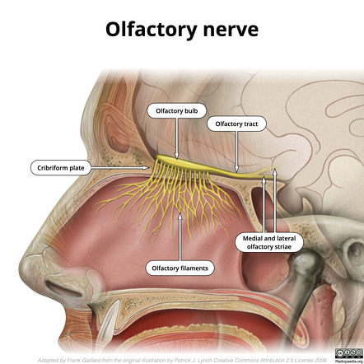
CN 1 - Olfactory Nerve
Function = Smell
Pathway:
Olfactory epithelium
Olfactory bulb
Olfactory tract
Primary olfactory cortex
Sensory Nerve (SVS)
Originates from the Cerebrum
Exits the skull via the Cribriform Plate
The Peer Teaching Society is not liable for false or misleading information…
Notes:
Special visceral sensory (SVS) – senses derived from endoderm (e.g. taste, smell).

Slide 20
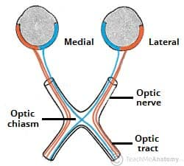
CN2 - Optic Nerve
Sensory nerve providing visions
Enters the skull via the optic canal through the sphenoid bone
The Peer Teaching Society is not liable for false or misleading information…

Slide 21
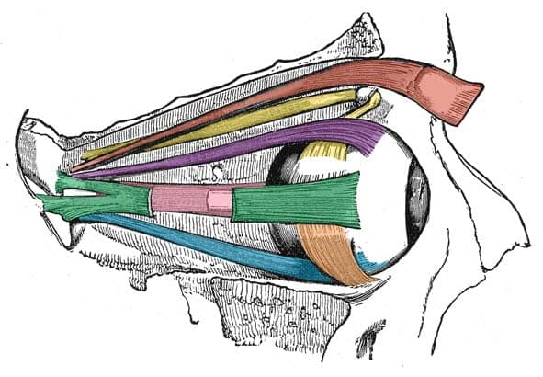
CN3 - Oculomotor Nerve
Motor supply to all the eye muscles except S,oblique, and L rectus
Sphincter pupillae constricts the pupil, cilliary muscles contracts for short range vision
Arises from the midbrain
Travels along the lateral cavernous sinus, leaves via the superior orbital fissure
The Peer Teaching Society is not liable for false or misleading information…

Slide 22
CN4 - Trochlear Nerve
Innervates the superior oblique- motor function
It arises from the trochelar nucleus of the posterior midbrain (only one to do so)
It moves along the lateral cavernous sinus, exits via the superior orbital fissure
The Peer Teaching Society is not liable for false or misleading information…

Slide 23
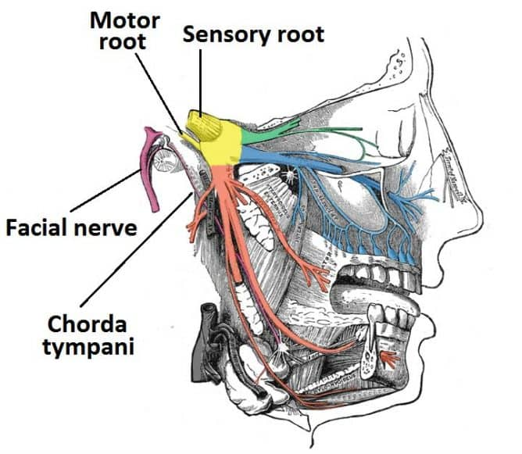
CN5 - Trigeminal Nerve
Sensory and motor functions
The sensory and motor nuclei arise from the midbrain, pons and medulla
The ophthalmic and maxillary nerve travel exit the cranium via the superior orbital fissure and foramen rotundum. The mandibular nerve via the foramen ovale
The Peer Teaching Society is not liable for false or misleading information…

Slide 24
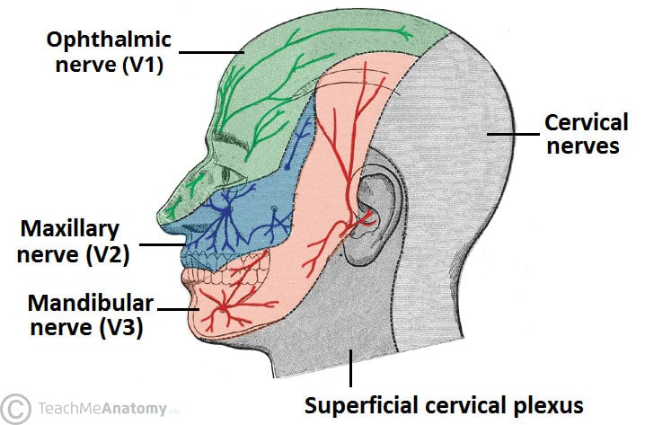
Trigeminal sensory and motor functions
Ophthalmic nerve- forehead and scalp, frontal and ethmoidal sinus, upper eyelid
Maxillary- lower eyelid, upper lip, nasal cavity
Lacrimal gland and nasal glands
Mandibular- Lower lip, chin. Anterior ⅔ of tongue.
Submandibular and sublingual glands
MUSCLES of mastication.
The Peer Teaching Society is not liable for false or misleading information…

Slide 25
CN6 - Abducens Nerve
Innervates the lateral rectus- motor function.
It travels in the cavernous sinus and leaves the skull via the superior orbital fissure.
It arises from the pons of the midbrain, leaving between the pons and the medulla
The Peer Teaching Society is not liable for false or misleading information…

Slide 26
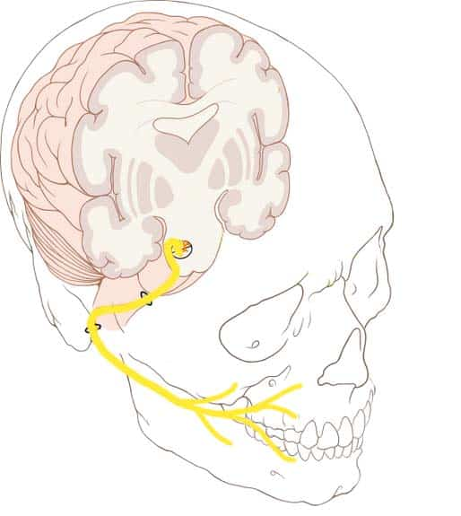
CN7 - Facial Nerve
o Controls muscles of facial expression
Gives taste for the anterior ⅔ of the tongue
Innervates the submandibular, sublingual, and lcarimal glands
o Arise from the pons, and both motor and sensory
oTravels in the internal acoustic meatus to leave via the stylomastoid foramen
The Peer Teaching Society is not liable for false or misleading information…
Notes:
functions :
GSS: sensation to part of ext. ear.
SVS: taste from ant. 2/3 tongue, hard and soft palate.
SVM: muscles of facial expression.
GVM: lacrimal, submandibular, sublingual glands and mucous glands of mouth and nose.

Slide 27
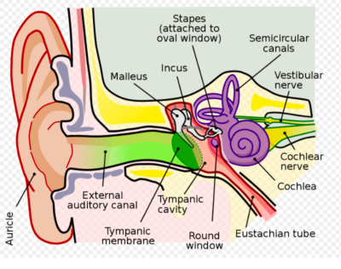
CN8 - Vestibulocochlear Nerve
Function = Hearing & Balance
Pathway:
Organ of Corti
Vestibular ganglion/ spiral ganglion
CN8
I AM
Into pontomedullary junction lateral to 6 + 7
Sensory Nerve (SSS)
Originates from the Pontine Medulla Junction
Exits the skull via the Internal Acoustic Meatus
The Peer Teaching Society is not liable for false or misleading information…
Notes:
Image Ref: https://www.physio-pedia.com/The_Vestibulocochlear_Nerve_%28CN_VIII%29
Special somatic sensory (SSS) – senses derived from ectoderm (e.g. sight, sound, balance).

Slide 28
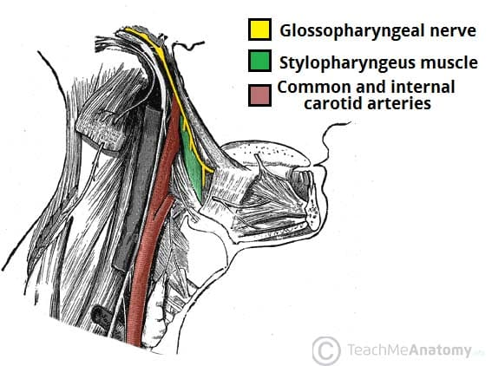
CN9 - Glossopharyngeal Nerve
Function:
Sensory : Pharynx, soft palate, external ear, posterior ⅓ of tongue, carotid sinus and body
Motor : stylopharyngeus muscle
Both Sensory & Motor
Originates from 3 nuclei in the Medulla
Exits the skull via the Jugular Foramen
The Peer Teaching Society is not liable for false or misleading information…
Notes:
Image Ref: https://teachmeanatomy.info/head/cranial-nerves/glossopharyngeal-nerve/
Originates Posterior to the olive
Functions:
SS: post. 1/3 tongue, ext. ear, and middle ear cavity.
GVS: carotid body and sinus.
SVS: taste from post. 1/3 tongue.
GVM: parotid gland.
SVM: stylopharyngeus

Slide 29
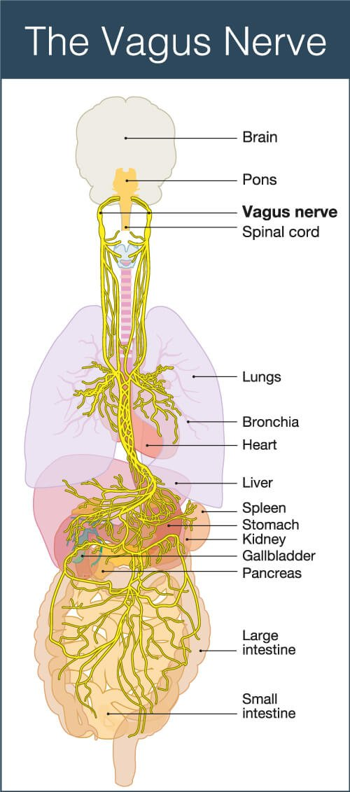
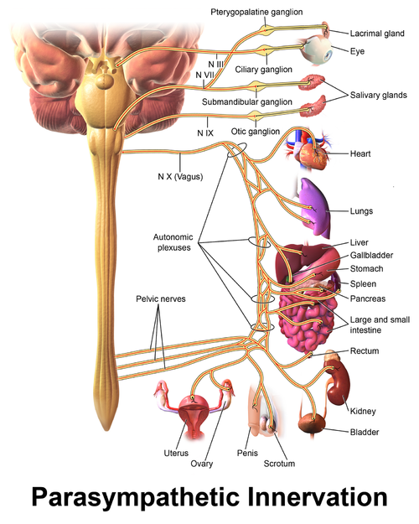
CN10 - Vagus Nerve
Function:
Sensory : aortic arch, thoracic viscera, larynx, abdominal viscera, external ear + epiglottis (taste)
Motor : muscles of soft palate (swallowing), pharyngeal muscles, Laryngeal muscles, Palatoglossus muscle
Parasympathetic: Thoracic viscera, GI tract
Both Sensory & Motor
Originates from the Medulla
Exits the skull via the Jugular Foramen
The Peer Teaching Society is not liable for false or misleading information…
Notes:
Image Ref: https://www.highpointaz.com/christinas-blog/the-power-of-the-vagus-nerve
https://www.physio-pedia.com/Vagus_Nerve
Originates posterior to the olive
GSS: ext. ear, larynx and pharynx.
GVS: larynx, pharynx and, thoracic & abdominal viscera.
SVS: taste from epiglottis region of tongue
GVM: smooth muscles of pharynx, larynx and most of the GIT.
SVM: most muscles of pharynx and larynx.

Slide 30
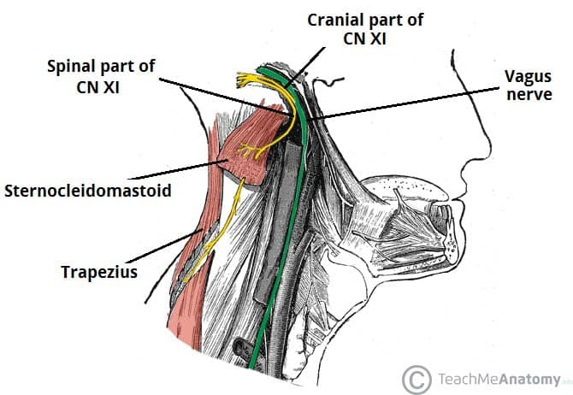
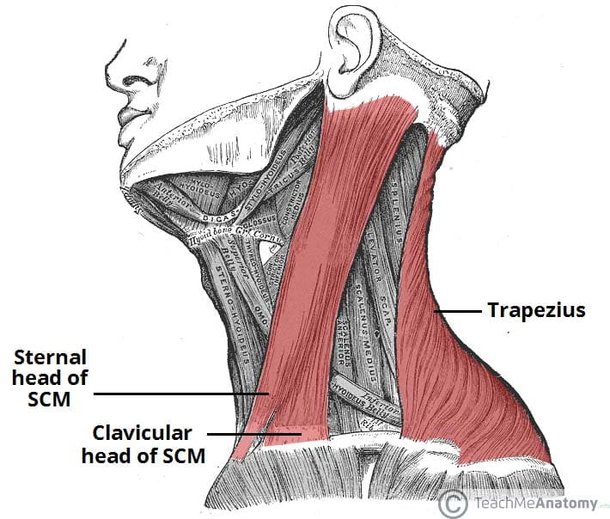
CN11 - Accessory Nerve
Function:
Cranial: accessory to CN10 in innervating the Pharyngeal muscles
Spinal: Sternocleidomastoid, Trapezius
Motor
Cranial component originates from the Medulla
Spinal component originates from C1-5
Exits the skull via the Jugular Foramen
The Peer Teaching Society is not liable for false or misleading information…
Notes:
Image Ref: https://teachmeanatomy.info/head/cranial-nerves/accessory/
https://teachmeanatomy.info/head/cranial-nerves/accessory/
The cranial component originates posterior to the olive

Slide 31
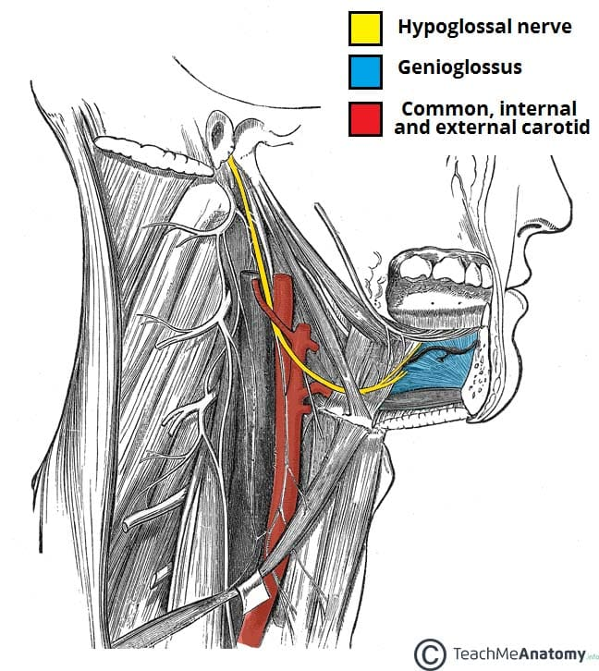
CN12 - Hypoglossal Nerve
Function: Intrinsic and Extrinsic tongue muscles (except the Palatoglossus (CNX)).
Motor
Originates from the Hypoglossal Nucleus - Medulla
Exits the skull via the Hypoglossal Canal
The Peer Teaching Society is not liable for false or misleading information…
Notes:
Image Ref: https://teachmeanatomy.info/head/cranial-nerves/hypoglossal/
Originates anterior to the olive

Slide 32
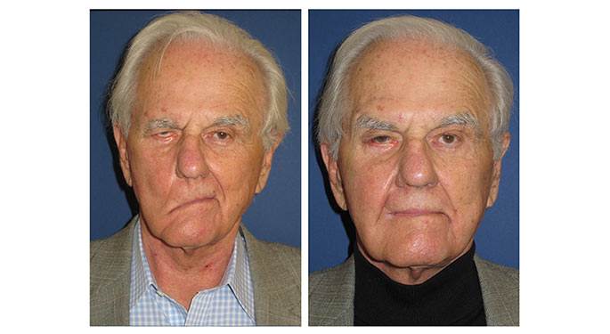
Question:
Which Cranial Nerve do you think has been damaged in this patient ?
The Peer Teaching Society is not liable for false or misleading information…
Notes:
Image Ref: https://www.mountsinai.org/care/ent/services/facial-plastic-reconstructive-surgery/facial-nerve-paralysis-before-and-after-gallery

Slide 33
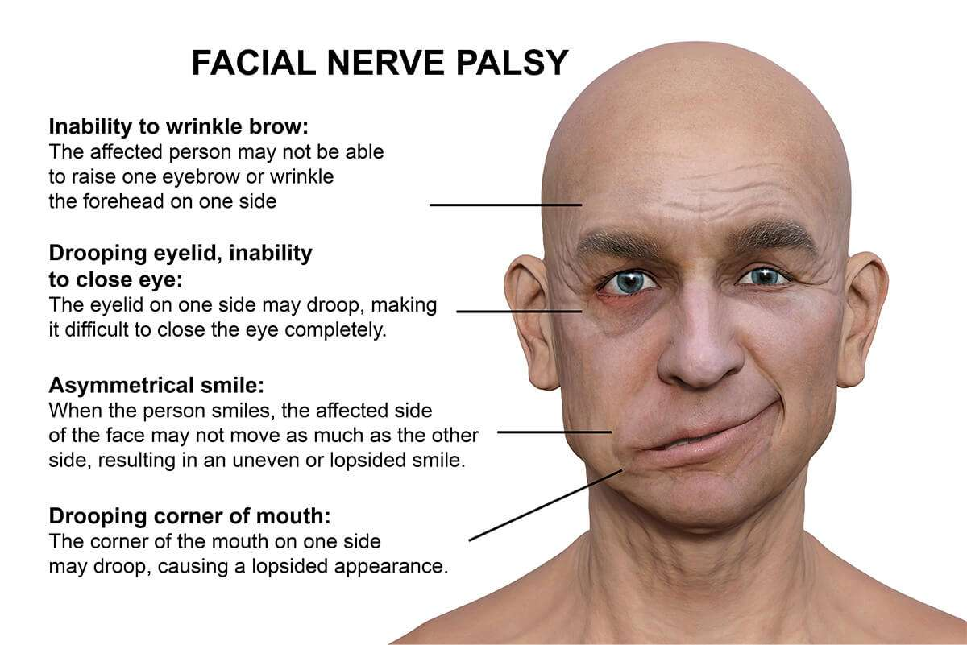
Answer:
Cranial Nerve 7
Facial Nerve
The Peer Teaching Society is not liable for false or misleading information…
Notes:
Image Ref: https://www.bergerhenryent.com/bells-palsy/

Slide 34
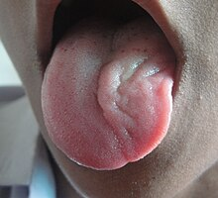
Question:
A patient is admitted to A&E where you suspect a head injury. You begin to test their cranial nerve functions and when asked to stick out their tongue, the patient looks like this:
What do you suspect has happened?
The Peer Teaching Society is not liable for false or misleading information…
Notes:
Image Ref: https://en.wikipedia.org/wiki/Hypoglossal_nerve

Slide 35
Answer:
Damage to 12th cranial nerve (hypoglossal nerve) on the left side.
In a 12th cranial nerve lesion the ipsilateral tongue muscles are paralysed. The contralateral muscles still function and ‘push’ the tongue to the weak side (to the same side as the lesion).
“Licks the Lesion”
The Peer Teaching Society is not liable for false or misleading information…

Slide 36
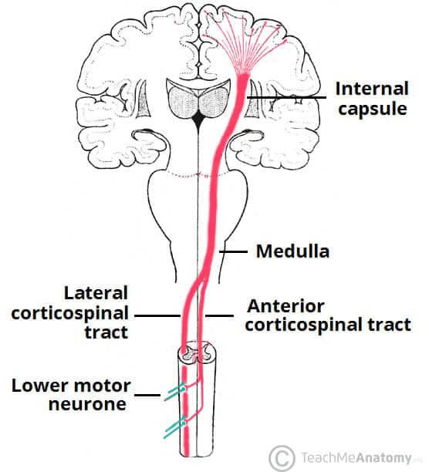
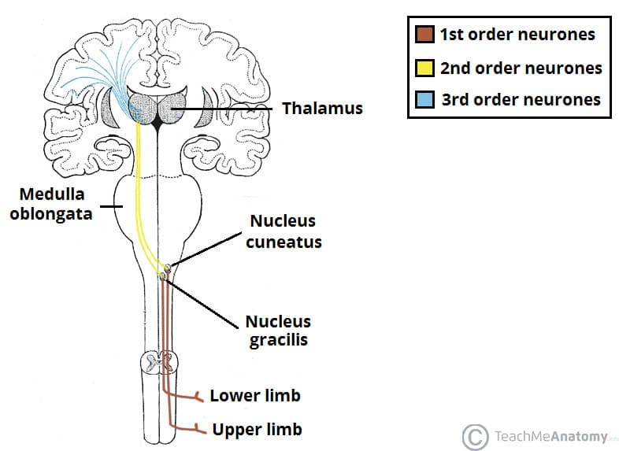
Pathways
Ascending Tracts
Descending Tracts
The Peer Teaching Society is not liable for false or misleading information…
Notes:
Image Ref:
https://teachmeanatomy.info/neuroanatomy/pathways/ascending-tracts-sensory/
https://teachmeanatomy.info/neuroanatomy/pathways/descending-tracts-motor/

Slide 37
Ascending Tracts
These are the neural pathways by which sensory information from the peripheral nerves is transmitted to the cerebral cortex.
Conscious Tracts:
DCML Pathway
Anterolateral System
Unconscious Tracts:
Spinocerebellar Tracts
The Peer Teaching Society is not liable for false or misleading information…

Slide 38
DCML
Dorsal Column-Medial Lemniscal Pathway
Carries the Sensory Information about:
Fine touch (tactile sensation)
Vibration
Proprioception
The Peer Teaching Society is not liable for false or misleading information…
Notes:
Image Ref: https://teachmeanatomy.info/neuroanatomy/pathways/ascending-tracts-sensory/

Slide 39
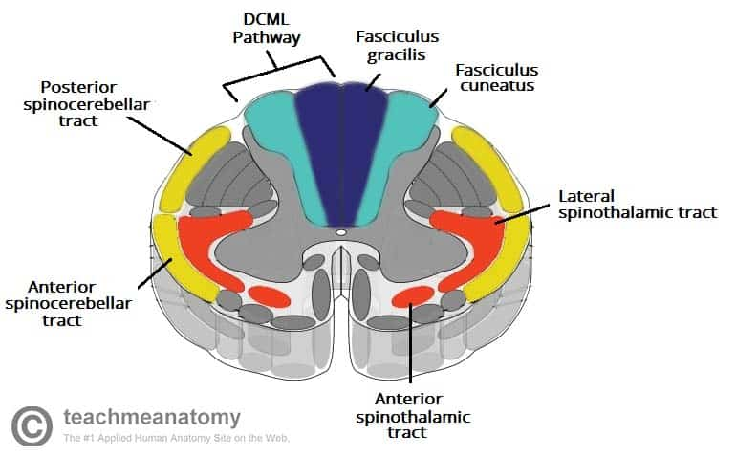
DCML: First Order Neurons
Signals from the Upper Limb:
T6 and Above
Fasciculus cuneatus
Synapse in the nucleus cuneatus
Signals from the Lower Limbs:
Below T6
Fasciculus gracilis
Synapse in the nucleus gracilis
The Peer Teaching Society is not liable for false or misleading information…
Notes:
Image Ref: https://teachmeanatomy.info/neuroanatomy/pathways/ascending-tracts-sensory/
Signals from the Upper Limb:
T6 and Above
Travel in the fasciculus cuneatus (the lateral part of the dorsal column)
Synapse in the nucleus cuneatus of the medulla oblongata
Signals from the Lower Limbs:
Below T6
Travel in fasciculus gracilis (the medial part of the dorsal column)
Synapse in the nucleus gracilis of the medulla oblongata

Slide 40
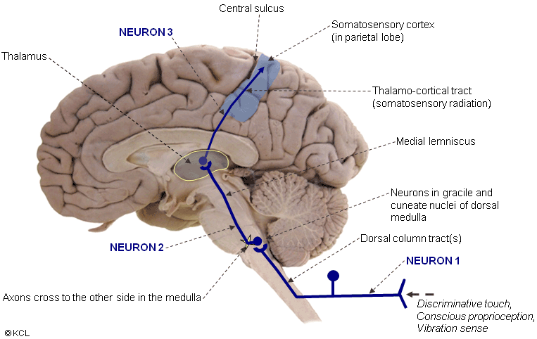
DCML : Second + Third Order Neurons
Second Order Neurons;
Cuneate/Gracilis Nucleus
Decussate in the medulla oblongata
Contralateral medial lemniscus
Thalamus
Third Order Neurons;
Ventral posterolateral nucleus of the thalamus
Internal capsule
Sensory Cortex
The Peer Teaching Society is not liable for false or misleading information…
Notes:
Image Ref; https://ehealth.kcl.ac.uk/tel/NA1-HTML5/Pages/1_1_AscendingSomato/1_1_2/1_1_2_DorsalColumn_MedLem_Pathway_on_ss_brain.html
Second Order Neurons;
Begin in cuneate nucleus or gracilis
Fibres receive the info from the preceding neurons
The fibres decussate in the medulla oblongata - then travel in the contralateral medial lemniscus to reach the thalamus.
Third Order Neurons;
They ascend from the ventral posterolateral nucleus of the thalamus
Travel through the internal capsule
Terminate at the sensory cortex

Slide 41
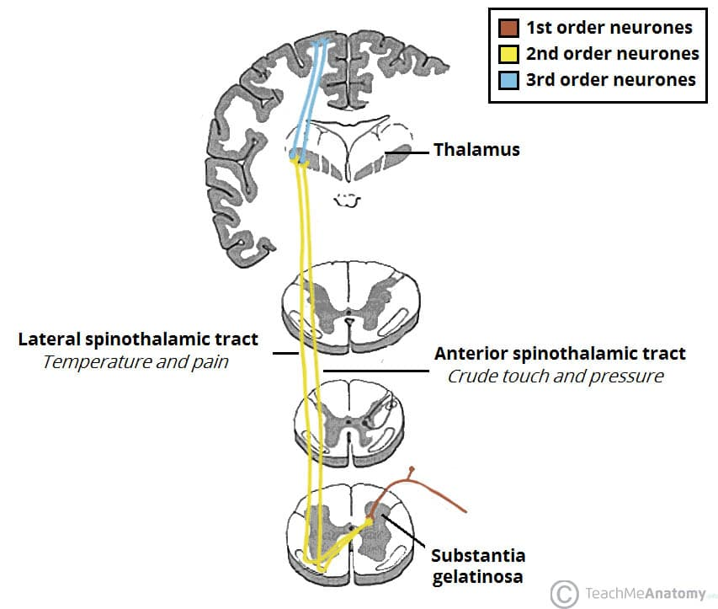
The Anterolateral System
Anterior Spinothalamic Tract:
Crude touch
Pressure
Lateral Spinothalamic Tract:
Pain
Temperature
The Peer Teaching Society is not liable for false or misleading information…
Notes:
Image Ref: https://teachmeanatomy.info/neuroanatomy/pathways/ascending-tracts-sensory/

Slide 42
Anterolateral System:
First Order Neurons:
Arise from the sensory receptors
Enter the spinal cord + Ascend ipsilaterally for 1-2 vertebral levels
Synapse at the Substantia Gelatinosa
Second Order Neurons:
Decussate in the spinal cord
Enter either the anterior or the lateral spinothalamic tract
Third Order Neurons:
ventral posterolateral nucleus of the thalamus
internal capsule
ipsilateral primary sensory cortex
The Peer Teaching Society is not liable for false or misleading information…
Notes:
First order:
Arise from the sensory receptors around the body
Enter the spinal cord
Ascend ipsilaterally for 1-2 vertebral levels
Synapse at the tip of the dorsal horn (“Substantia Gelatinosa”)
Second Order Neurons:
Synapse with the first order neurons
Decussate in the spinal cord and enter either the anterior or the lateral spinothalamic tract
Third Order Neurons:
Synapse with the second order neurons
Ascend from the ventral posterolateral nucleus of the thalamus
Travel through the internal capsule
Terminate in the ipsilateral primary sensory cortex

Slide 43
The Spinocerebellar Tracts
Posterior Spinocerebellar tract
Proprioception from the lower limbs to the ipsilateral cerebellum
Cuneocerebellar tract & Rostral Spinocerebellar Tract
Proprioception from the upper limbs to the ipsilateral cerebellum
Anterior Spinocerebellar tract
Proprioception from the lower limbs.
Fibres decussate TWICE
Ipsilateral cerebellum
The Peer Teaching Society is not liable for false or misleading information…
Notes:
Image Ref: https://teachmeanatomy.info/neuroanatomy/pathways/ascending-tracts-sensory/

Slide 44
Question:
A patient comes into A&E after they’ve been in an accident where they were stabbed in the back.
Upon assessment, you notice that they have no sensation of temperature on the left side of their body as well and they can’t feel you touching their right shoulder/arm.
What has happened here?
The Peer Teaching Society is not liable for false or misleading information…

Slide 45
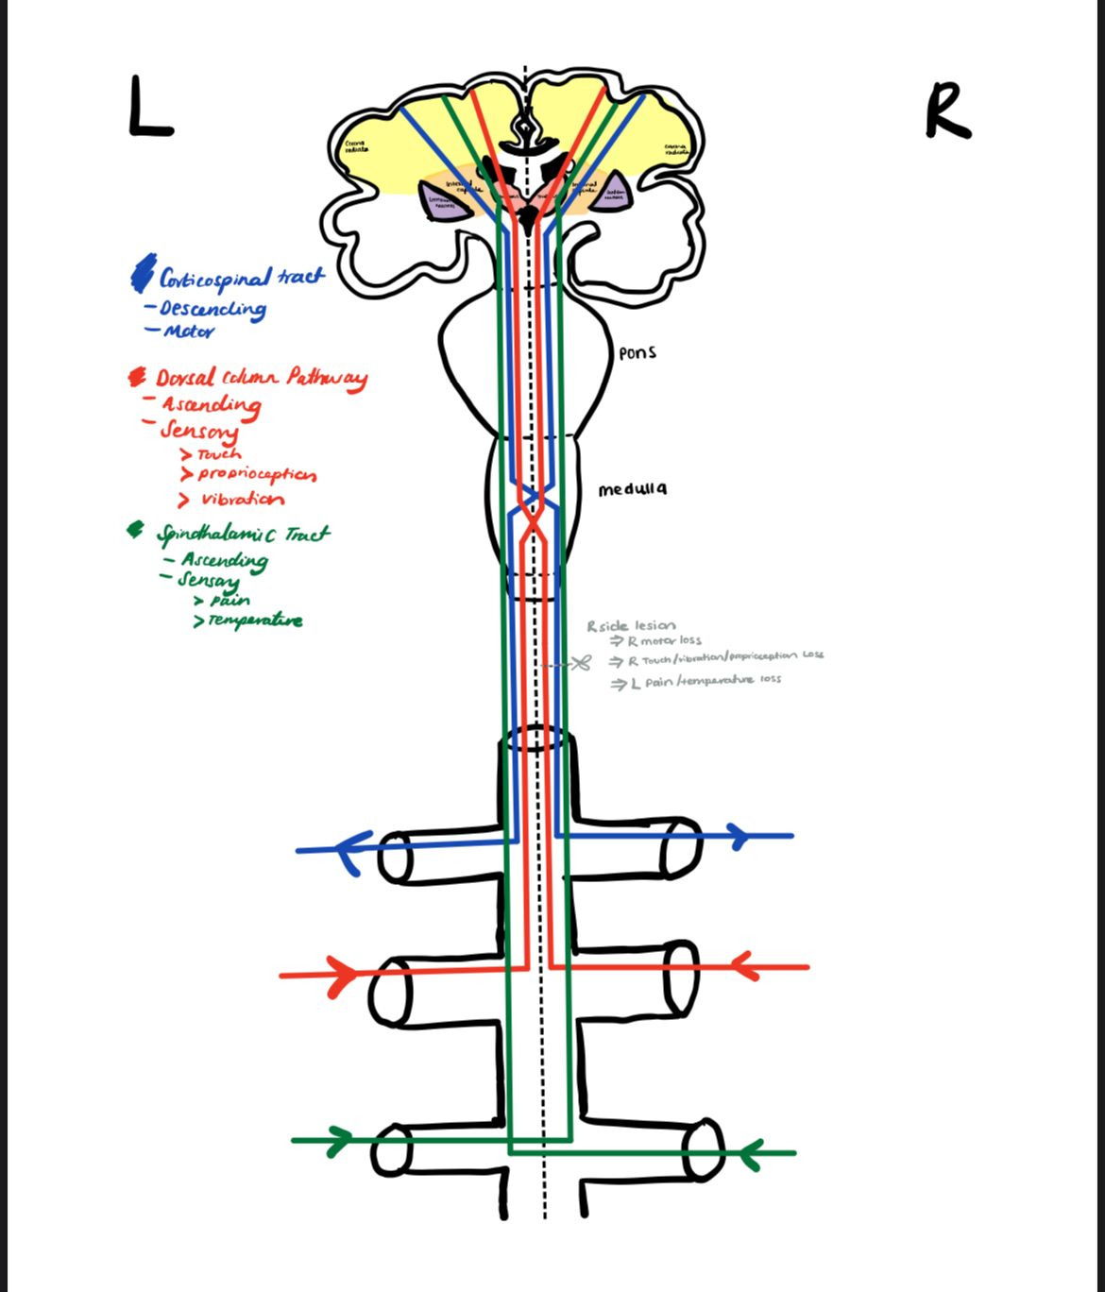
Answer:
Brown Sequard Syndrome
Hemisection of the spinal cord
Presentation :
Ipsilateral loss of touch, vibration and proprioception
Contralateral loss of pain and temperature sensation
The Peer Teaching Society is not liable for false or misleading information…
Notes:
(I drew this picture so it doesn't need a reference)

Slide 46
Question:
The DCML pathway is associated with which type of sensory information:
Temperature perception
Pain sensation
Proprioception and fine touch
Auditory processing
Visual perception
The Peer Teaching Society is not liable for false or misleading information…

Slide 47
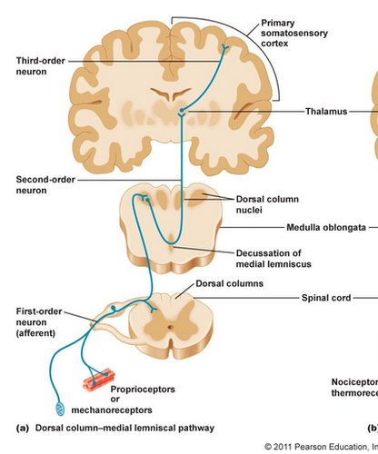
Answer:
C. Proprioception and Fine Touch
The Peer Teaching Society is not liable for false or misleading information…
Notes:
Image Ref: https://quizlet.com/516952710/sensory-motor-systems-review-flash-cards/

Slide 48
Descending Tracts
Motor signals from the brain to lower motor neurons.
Pyramidal Tracts:
Corticospinal tract
Corticobulbar tract
Extrapyramidal Tracts;
Vestibulospinal tracts
Reticulospinal tracts
Rubrospinal tracts
Tectospinal tracts
The Peer Teaching Society is not liable for false or misleading information…
Notes:
Pyramidal tracts – These tracts originate in the cerebral cortex, carrying motor fibres to the spinal cord and brain stem. They are responsible for the voluntary control of the musculature of the body and face.
Extrapyramidal tracts – These tracts originate in the brain stem, carrying motor fibres to the spinal cord. They are responsible for the involuntary and automatic control of all musculature, such as muscle tone, balance, posture and locomotion
There are no synapses within the descending pathways. At the termination of the descending tracts, the neurones synapse with a lower motor neurone. Thus, all the neurones within the descending motor system are classed as upper motor neurones. Their cell bodies are found in the cerebral cortex or the brain stem, with their axons remaining within the CNS.

Slide 49
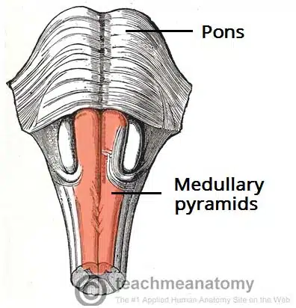
Pyramidal Tracts
These tracts are responsible for the voluntary control of the musculature of the body and face.
Corticospinal Tracts
Supplies the musculature of the body
Corticobulbar Tracts
Supplies the musculature of the head and neck
The Peer Teaching Society is not liable for false or misleading information…
Notes:
Image Ref: https://teachmeanatomy.info/neuroanatomy/pathways/descending-tracts-motor/

Slide 50
Corticospinal Tracts
Corticospinal tracts begin in the cerebral cortex:
Primary motor cortex
Premotor cortex
Supplementary motor area
Converge and descend through the internal capsule
Neurons pass through the crus cerebri
In the caudal part of the medulla, the tract divides into :
Lateral corticospinal tract
Anterior corticospinal tract
The Peer Teaching Society is not liable for false or misleading information…
Notes:
Image Ref: https://teachmeanatomy.info/neuroanatomy/pathways/descending-tracts-motor/
- Corticospinal tracts begin in the cerebral cortex:
Primary motor cortex
Premotor cortex
Supplementary motor area
- Converge and descend through the internal capsule
- Neurons pass through the crus cerebri of the midbrain, the pons and into the medulla
- In the caudal part of the medulla, the tract divides into : -
- Lateral corticospinal tract decussate and then descend into the spinal cord + terminate at the ventral horn. From here, the lower motor neurons go on to supply the muscles of the body.
- Anterior corticospinal tract remains ipsilateral, descending into the spinal cord. They then decussate and terminate in the ventral horn of the cervical and upper thoracic segmental levels.

Slide 51
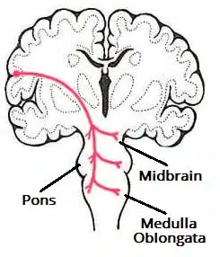
Corticobulbar Tracts
Arise from the lateral aspect of the primary motor cortex
The fibres converge and pass through the internal capsule to the brainstem.
The neurons terminate on the motor nuclei of the cranial nerves. Here they synapse with lower motor neurons, which carry the motor signals to the muscles of the face and neck.
The Peer Teaching Society is not liable for false or misleading information…
Notes:
Image Ref: https://teachmeanatomy.info/neuroanatomy/pathways/descending-tracts-motor/
(receive the same inputs as the corticospinal tracts).
Clinically, it is important to understand the organisation of the corticobulbar fibres. Many of these fibres innervate the motor neurons bilaterally.
For example, fibres from the left primary motor cortex act as upper motor neurons for the right and left trochlear nerves. There are a few exceptions to this rule:
Upper motor neurons for the facial nerve (CN VII) have a contralateral innervation. This only affects the muscles in the lower quadrant of the face – below the eyes. (The reasons for this are beyond the scope of this article)
Upper motor neurons for the hypoglossal (CN XII) nerve only provide contralateral innervation.

Slide 52
Extrapyramidal Tracts
Originate in the brainstem, carrying motor fibres to the spinal cord.
They are responsible for the involuntary and automatic control of all musculature:
Muscle tone
Balance
Posture
Locomotion
The vestibulospinal and reticulospinal tracts do NOT decussate = provide ipsilateral innervation
The rubrospinal and tectospinal tracts do decussate = contralateral innervation.
The Peer Teaching Society is not liable for false or misleading information…

Slide 53
Vestibulospinal Tracts
Medial and lateral pathways
Arise from vestibular nuclei
Receive input from organs of balance
Ipsilateral
Control balance + posture
Innervates the flexors of the arm, extensors of the leg via lower motor neurons
Reticulospinal tracts
Medial tract
Arises from the pons
Facilitates voluntary movements and increases muscle tone
Lateral tract
Arises from the medulla
Inhibits voluntary movements + reduced muscle tone
The Peer Teaching Society is not liable for false or misleading information…

Slide 54
Rubrospinal Tracts
Originates from the red nucleus
Decussate
Contralateral innervation
Function is unclear
Fine control of hand movements?
Tectospinal Tracts
Begins at the superior colliculus (receives input from the optic nerves)
Decussate
Terminate at the cervical levels of the spinal cord
Coordinates movements of the head in relation to vision stimuli
The Peer Teaching Society is not liable for false or misleading information…

Slide 55
Question:
Which of these tracts does not decussate in the spinal cord?
Vestibulospinal Tract
Rubrospinal Tract
Tectospinal Tract
Anterior Cerebellar Tract
DCML Pathway
The Peer Teaching Society is not liable for false or misleading information…

Slide 56
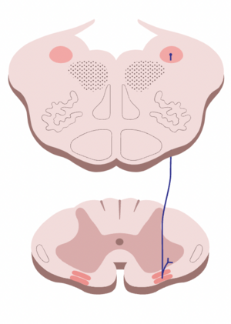
Answer:
Vestibulospinal Tract
The Peer Teaching Society is not liable for false or misleading information…
Notes:
Image Ref: https://www.physio-pedia.com/Vestibulospinal_Tract

Slide 57
Question:
What role do spinal descending tracts play in motor control?
The Peer Teaching Society is not liable for false or misleading information…

Slide 58
Answer:
Spinal descending tracts are pathways that carry motor commands from the brain to the spinal cord, enabling the initiation and modulation of voluntary muscle movements and contributing to coordinated motor control.
Or something along the lines of that ^^^ :)
The Peer Teaching Society is not liable for false or misleading information…

Slide 59
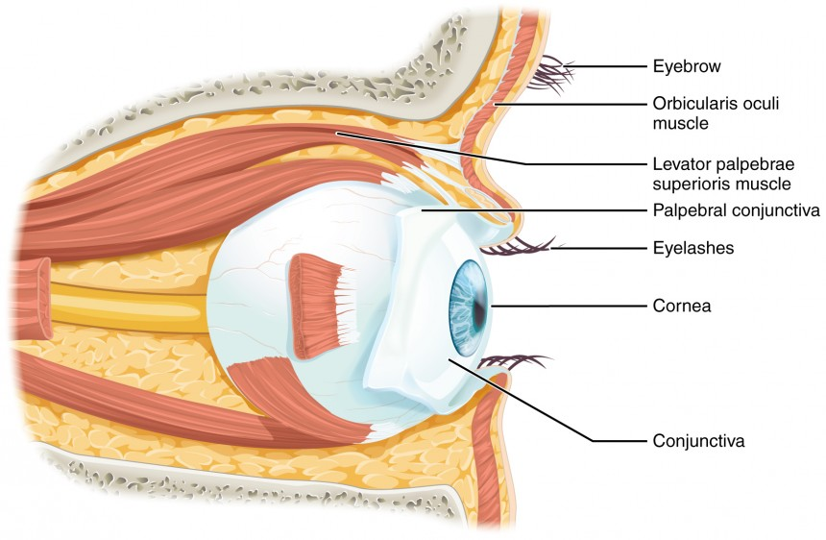
Vision
Retina Structure
Rod Cells
Cone Cells
Phototransduction
The Peer Teaching Society is not liable for false or misleading information…
Notes:
Image Ref: https://courses.lumenlearning.com/suny-ap1/chapter/vision/

Slide 60
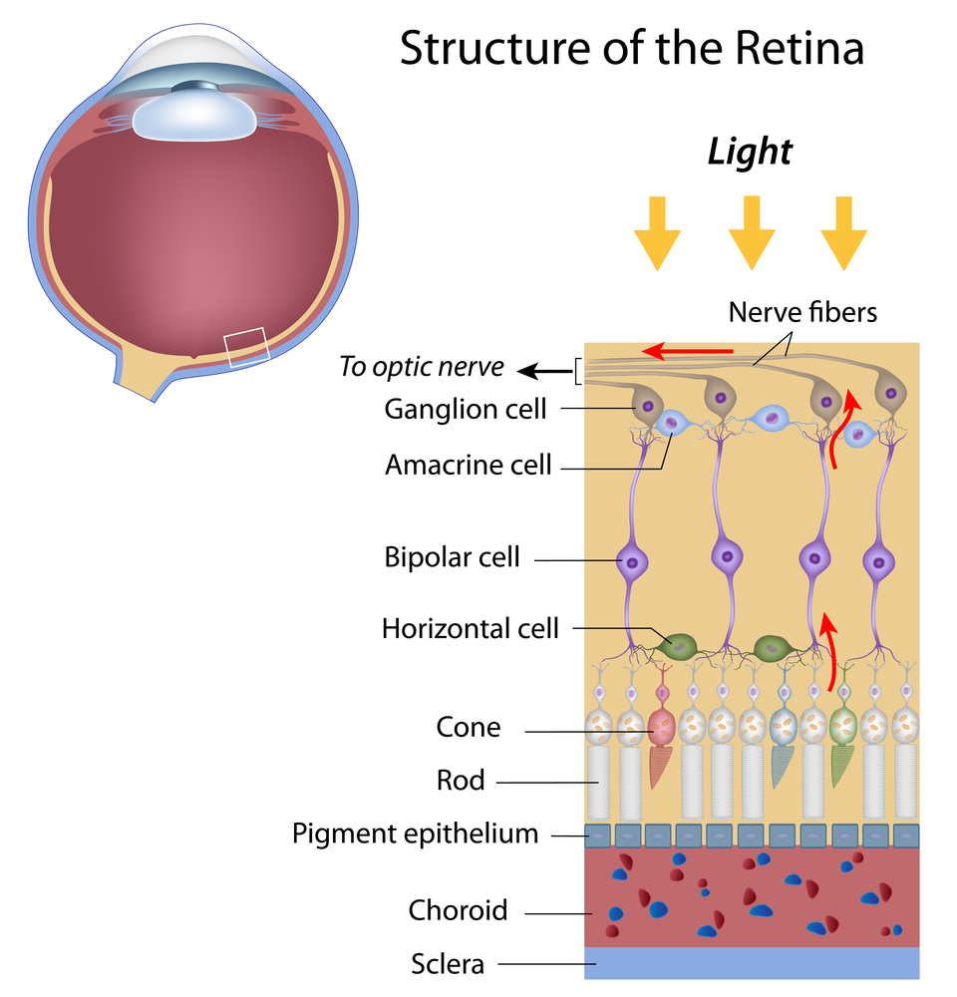
Retina Structure
Pigmented layer
Neural layer
Bipolar cells
Ganglion cells - synapse in the lateral geniculate body
The Peer Teaching Society is not liable for false or misleading information…
Notes:
Image Ref: https://discoveryeye.org/layers-of-the-retina/
Neural layers - photoreceptors
Function of the retina - transducer converts light image → electrical signal
Signals in the retina:
Photorecptor → bipolar cell → retinal ganglion cell
Horizontal and apocrine cells modulate signal
Retinal ganglion cells → action potential

Slide 61
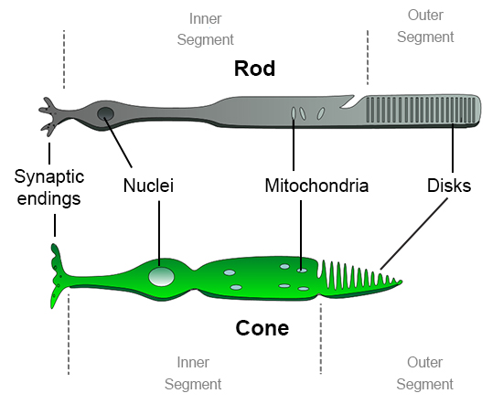
Rod & Cone Cells
Rods
Function in dim light and are insensitive to colour
Located in the periphery of the retina
Monochromatic vision
Cones
Respond to bright light and are sensitive to colour
Located in fovea
The Peer Teaching Society is not liable for false or misleading information…
Notes:
Image Ref: https://askabiologist.asu.edu/rods-and-cones

Slide 62
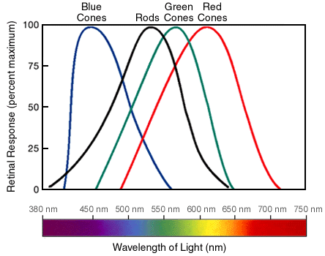
Phototransduction
Rhodopsin pigment in Rod cells
Cone opsin in cone cells
Photon causes a conformational change to rhodopsin molecule
This triggers change in opsin molecule structure
This triggers a cascade within the cell
The Peer Teaching Society is not liable for false or misleading information…
Notes:
Image Ref: https://askabiologist.asu.edu/rods-and-cones
Opsins are transmembrane proteins which contain the light sensitive molecule retinal
Different opsin structures mean retinal absorbs different wavelengths of light

Slide 63
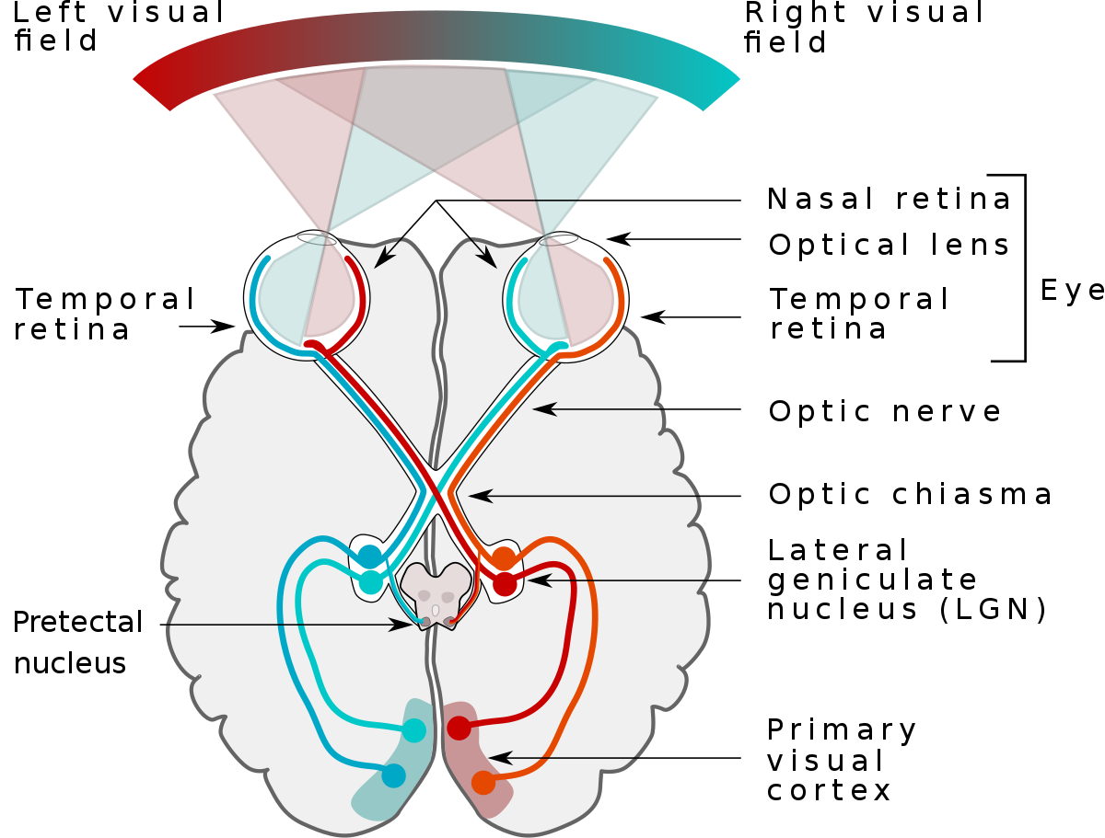
Visual Pathway
The Peer Teaching Society is not liable for false or misleading information…

Slide 64
Visual pathway
This arises from the two optic nerves leaving the eye
They join at the optic chiasm, with Lateral fibres staying ipsilateral. Medial fibres move contralaterally.
The Peer Teaching Society is not liable for false or misleading information…

Slide 65
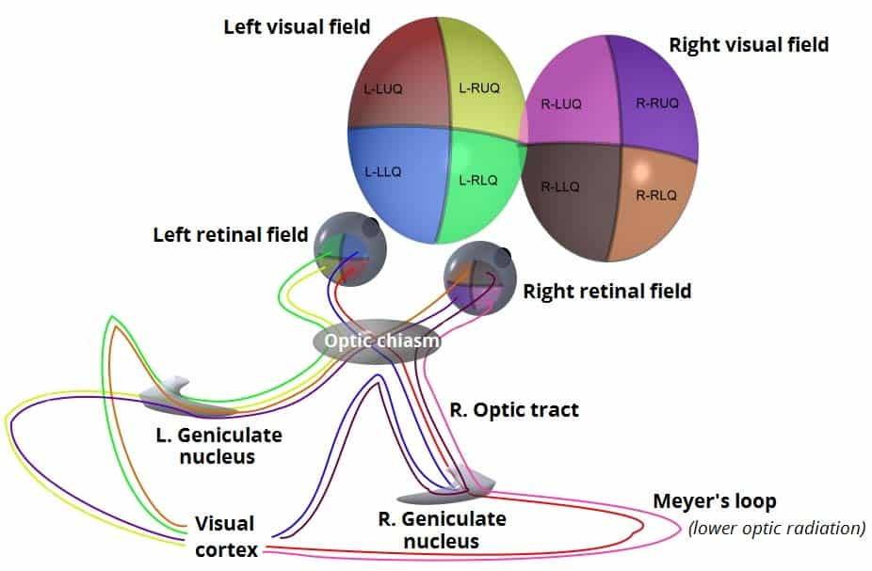
Upper and lower radiation
At the lateral geniculate nucleus the optic tracts split.
The upper optic radiation carries light from the, superior retinal quadrants, via the parietal lobe.
UPPer- Parietal
The lower optic radiation carries light from the inferior retinal quadrants via the temporal lobe
Lower stays LOW
The Peer Teaching Society is not liable for false or misleading information…

Slide 66
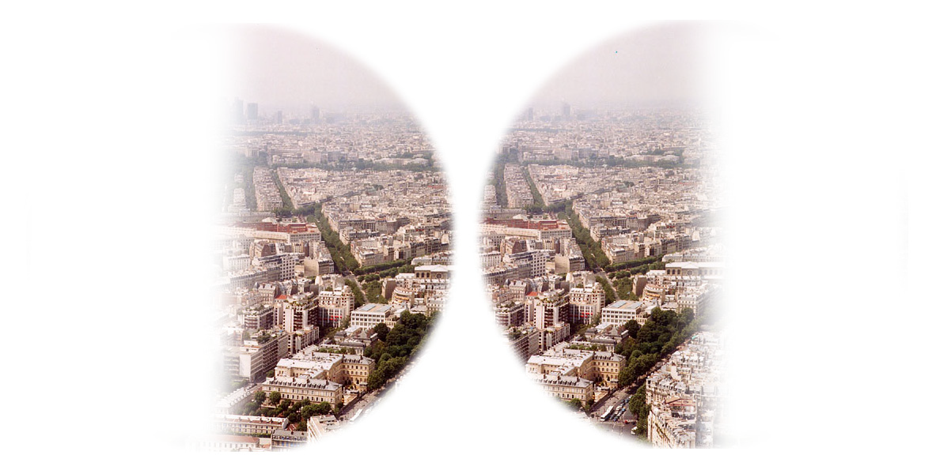
Question:
A patient comes into your clinic complaining of having “tunnel vision”. They’re anxious and worried as their dad had “some kind of brain cancer” and he is worried that it may have a cancer too.
The patient’s CT scan shows a pituitary tumour. Explain his visual disturbance.
The Peer Teaching Society is not liable for false or misleading information…
Notes:
Image Ref: https://en.wikipedia.org/wiki/Bitemporal_hemianopsia

Slide 67
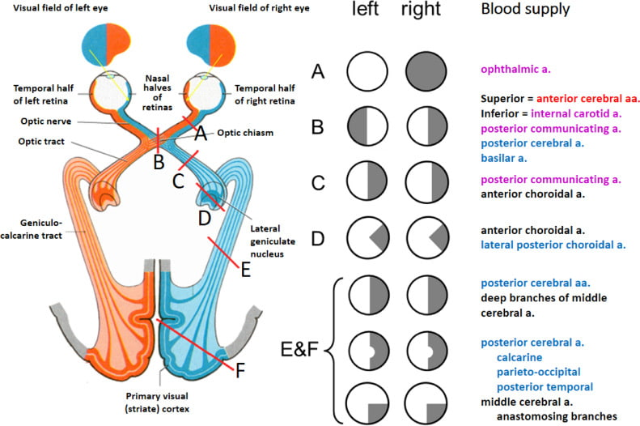
Answer:
Bitemporal Hemianopia
Their pituitary tumor is pressing against the optic chiasm where the 2 lateral viewing nerves cross, hence they only have medial visual fields.
The Peer Teaching Society is not liable for false or misleading information…
Notes:
Image Ref: https://ophthalmologybreakingnews.com/bitemporal-hemianopia--causes-symptoms-and-management

Slide 68
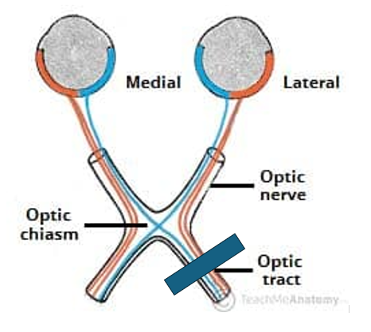
Question:
You see a patient with the below lesion. What would the visual defect be?
Totoal visual loss
Left nasal hemianopia
Left homonymous hemianopia
Bitemporal heminaopia
The Peer Teaching Society is not liable for false or misleading information…

Slide 69
Answer:
Left homonymous hemianopia
In this lesion the medial fibres of the left eye, and the lateral fibers of the right eye have been affected.
This results in the left sided vision being lost in both eyes, giving the below visual field
The Peer Teaching Society is not liable for false or misleading information…

Slide 70
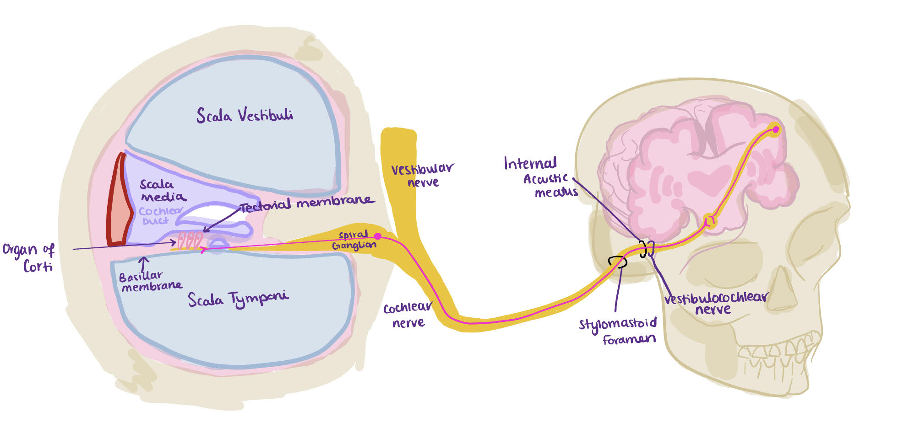
Auditory System
The Peer Teaching Society is not liable for false or misleading information…
Notes:
(this doesn’t need a reference as I drew it)

Slide 71
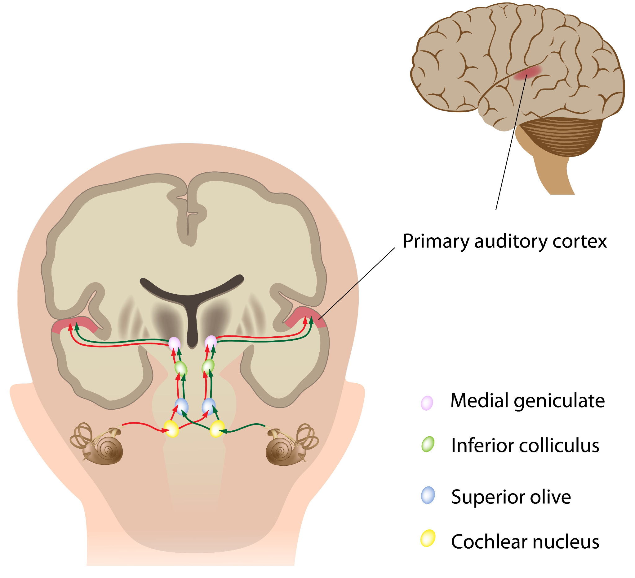
Auditory Pathway
Sound Pathway
Sound
External Acoustic meatus
Vibration of the tympanic membrane
Vibration of the ossicles
Oval window
Fluid filled Cochlea receives the vibrations
Organ of Corti
Basilar membrane
Hair cell depolarisation
Cochlear nerve
CN VIII
CNS
The Peer Teaching Society is not liable for false or misleading information…
Notes:
External ear = air filled
Middle ear = air filled
Inner ear = fluid filled

Slide 72
Auditory Pathway
Cochlear hair cell receptors in the organ of corti
Ultimately reaches the primary auditory cortex for conscious perception
Unconscious processing of auditory information occurs in parallel
Primary lemniscal pathway
Main pathway
Auditory information reaches the primary auditory cortex
Non-lemniscal pathway
Mediating unconscious perception like attention, emotional response + auditory reflexes
The Peer Teaching Society is not liable for false or misleading information…

Slide 73
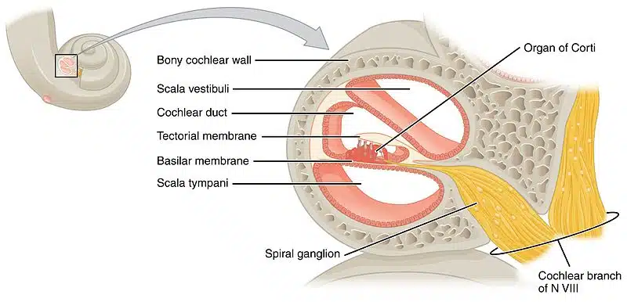
The Peer Teaching Society is not liable for false or misleading information…
Notes:
Image Ref: https://teachmeanatomy.info/neuroanatomy/pathways/auditory-pathway/

Slide 74
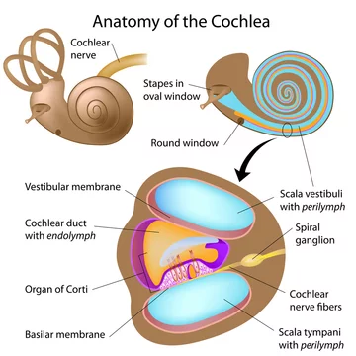
Primary Pathway
Spiral Ganglion:
Receive signals from the hair cells in the organ of corti
Travel within the osseous spiral lamina
Vestibular nerve + cochlear nerve = vestibulocochlear nerve (after they enter the acoustic meatus)
The Peer Teaching Society is not liable for false or misleading information…
Notes:
Image Ref: https://stock.adobe.com/uk/search?k=%22spiral+ganglion%22
The spiral ganglion houses the cell bodies of the first order neurons (ganglion refers to a collection of cell bodies outside the central nervous system). These neurons receive information from hair cells in the Organ of Corti and travel within the osseous spiral lamina. Their central axons form the main component of the cochlear nerve.
The vestibular nerve joins the cochlear nerve entering the internal acoustic meatus, and from this point onward they are collectively called vestibulocochlear nerve. This proximity is clinically relevant since lesions to this nerve will usually produce symptoms in both the auditory and vestibular components.
the nerve enters the cranium through the internal acoustic meatus and travels a short distance (around 1 cm) to enter the brainstem at the cerebellopontine angle.

Slide 75
Cochlear Nuclei
Ventral cochlear nucleus;
Where the nerve enters the brainstem
Some fibres ascend in the lateral lemniscus bilaterally
Most fibres decussate to the contralateral superior olivary nuclei.
Projects upwards through the lateral lemniscus
Dorsal cochlear nucleus;
Posterior to the inferior cerebellar peduncle
Small bump on the surface of the brainstem - “auditory tubercle”
mos t fibres cross the midline and ascend in the contralateral lateral lemniscus
Other fibres ascend in the ipsilateral lateral lemniscus
The Peer Teaching Society is not liable for false or misleading information…
Notes:
The Superior Olivary nucleus is next to the Trapezoid body

Slide 76
Inferior Colliculus + Medial Geniculate Body
Fibres ascending through the lateral lemniscus from both the cochlear nuclei and the superior olivary nuclei arrive at the inferior colliculus. Where they converge
Fibres project to the ipsilateral medial geniculate body in the thalamus
Fibres from here project to the primary auditory cortex
The primary auditory cortex is located in the superior temporal gyrus, under the lateral fissure
The Peer Teaching Society is not liable for false or misleading information…
Notes:
Vision is relayed to the lateral geniculate body
I AM Auditory - Inferior Colliculus. Auditory, Medial Geniculate body
Music - medial
Light - lateral

Slide 77
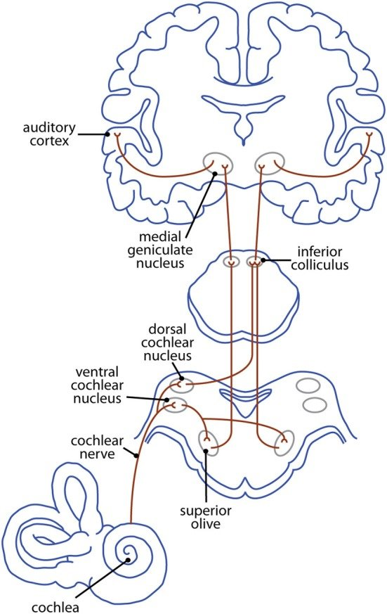
Central Auditory Pathway
Eighth CN + ear receptors
Cochlear nucleus
Superior Olivary nucleus
Lateral lemniscus
Inferior Colliculus
Medial geniculate body
Auditory cortex
ECOLIMA
The Peer Teaching Society is not liable for false or misleading information…
Notes:
Information travels from the receptors in the organ of Corti of the inner ear (cochlear hair cells) to the central nervous system, carried by the vestibulocochlear nerve (CN VIII).

Slide 78
Question:
Where does the vestibulocochlear nerve exit the skull?
Jugular Foramen
Hypoglossal Canal
Medial geniculate body
Internal acoustic meatus
External acoustic meatus
The Peer Teaching Society is not liable for false or misleading information…

Slide 79
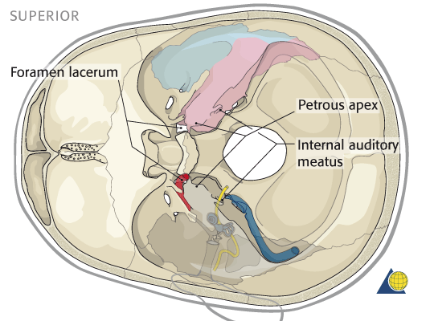
Answer:
D . Internal acoustic meatus
The Peer Teaching Society is not liable for false or misleading information…
Notes:
Image Ref: https://ranzcrpart1.fandom.com/wiki/Intracranial_cavity_(extra_axial):_Posterior_cranial_fossa:Internal_auditory_meatus_with_CN_VII_%26_VIII

Slide 80
Question:
In the auditory pathway, what is the primary function of the cochlea?
Amplifying sound waves
Converting sound vibrations into electrical signals
Filtering background noise
Transmitting signals to the auditory cortex
To hear
The Peer Teaching Society is not liable for false or misleading information…

Slide 81
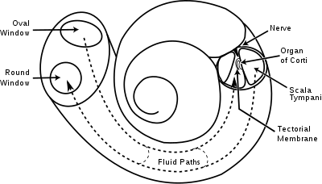
Answer:
B. Converting sound vibrations into electrical signs
The Peer Teaching Society is not liable for false or misleading information…
Notes:
Image Ref: https://en.wikipedia.org/wiki/Cochlea

Slide 82
Question:
Which part of the ear is responsible for maintaining balance and spatial orientation in addition to its role in the auditory pathway?
Pinna
Eardrum
Vestibular System
Cochlea
Tympanic membrane
The Peer Teaching Society is not liable for false or misleading information…

Slide 83
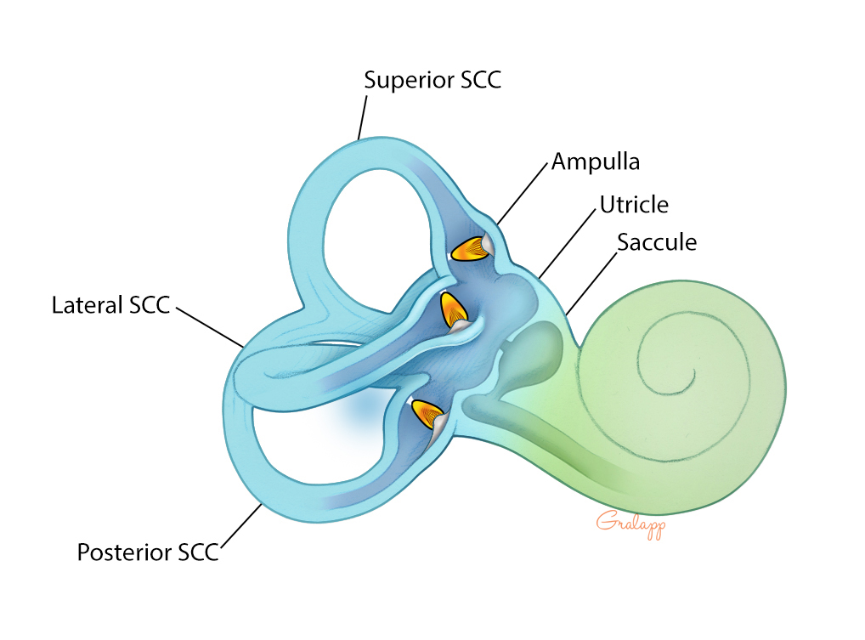
Answer:
C. Vestibular System
The Peer Teaching Society is not liable for false or misleading information…
Notes:
Image Ref: https://otosurgeryatlas.stanford.edu/otologic-surgery-atlas/surgical-anatomy-of-the-ear/vestibular-system/

Slide 84
Useful Resources
https://teachmephysiology.com/
https://teachmeanatomy.info/
https://www.osmosis.org/home/dashboard
https://www.peerteaching.co.uk/phase-1.html
The Peer Teaching Society is not liable for false or misleading information…

Slide 85
Conclusion
We have covered:
Cerebral Vasculature
Cranial Nerves
Pathways
Vision
Auditory System
Any Questions????
The Peer Teaching Society is not liable for false or misleading information…
Notes:
Image Ref: https://smarticons.co/blog/understanding-the-meaning-of-question-mark-icons/

Slide 86
Feedback
https://forms.gle/69K5s6HDBUeNQ9Dj7
The Peer Teaching Society is not liable for false or misleading information…

